Slide 1
REPORT
Created by : Sakshi Shishir Chandanshive

Slide 2
Report
Title : Reflected Cross-site Scripting (XSS)
Domain : http://vulnweb.com/
Sub-domain : http://testphp.vulnweb.com/
Tool used : Burpsuite
Reflected Cross-site Scripting (XSS) occur when an attacker injects browser executable code within a single HTTP response.When a web application is vulnerable to this type of attack, it will pass unvalidated input sent through requests back to the client.
The value of request parameter is copied into the value of an HTML tag attribute which is encapsulated in double quotation marks.The input was echoed unmodified in the application's response. This proof-of-concept attack demonstrates that it is possible to inject arbitrary JavaScript into the application's response.

Slide 3
Steps:
Open the burpsuite and browser. Copy the sub-doamain url.
Click on intercept on button.
Then enter the html script in the search box of the browser.
You will get the response on the burpsuite, then right click and click on send to repeater.
Hit on the send button of the repeater's sub tab and will find the response.
Right click within the response tab and click on show response on browser and click on the copy button
Paste the copied URL in the web browser you will find the popup which will display the domain of the website.

Slide 4
Impact
Cookie Stealing - A malicious user can steal cookies and use them to gain access to the application.
Arbitrary requests - An attacker can use XSS to send requests that appear to be from the victim to the web server.
Malware download - XSS can prompt the user to download malware. Since the prompt looks like a legitimate request from the site, the user may be more likely to trust the request and actually install the malware.
Defacement - attacker can deface the website usig javascript code.
Mitigation :
Input should be validated as strictly as possible on arrival, given the kind of content that it is expected to contain.
User input should be HTML-encoded at any point where it is copied into application responses. All HTML metacharacters, including < > " ' and =, should be replaced with the corresponding HTML entities (< > etc).

Slide 5
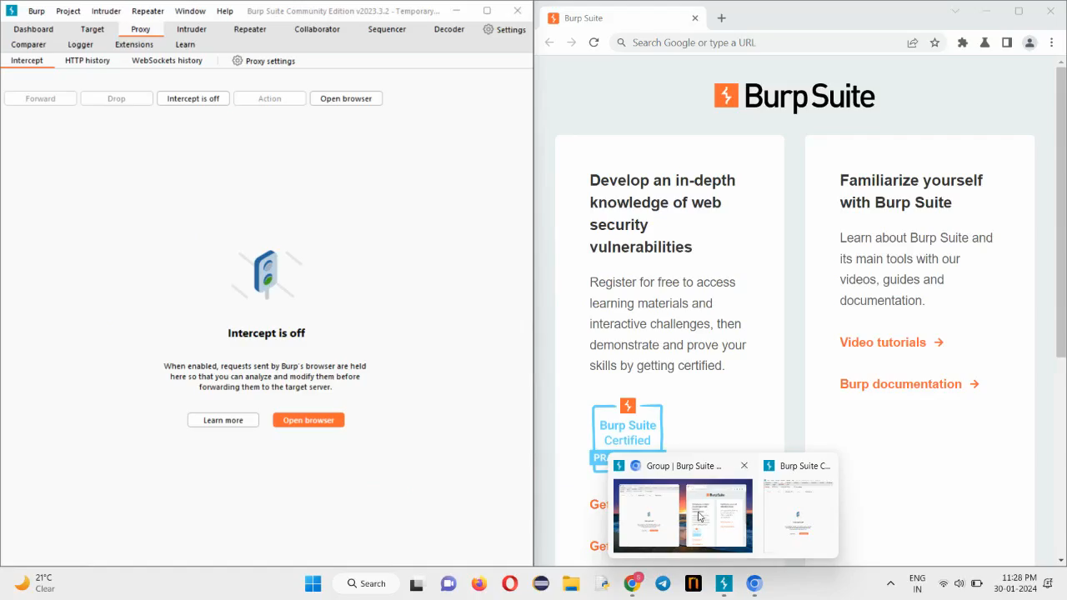
In the attachment below is the request, response video of vulnerability using burpsuite.

Slide 6
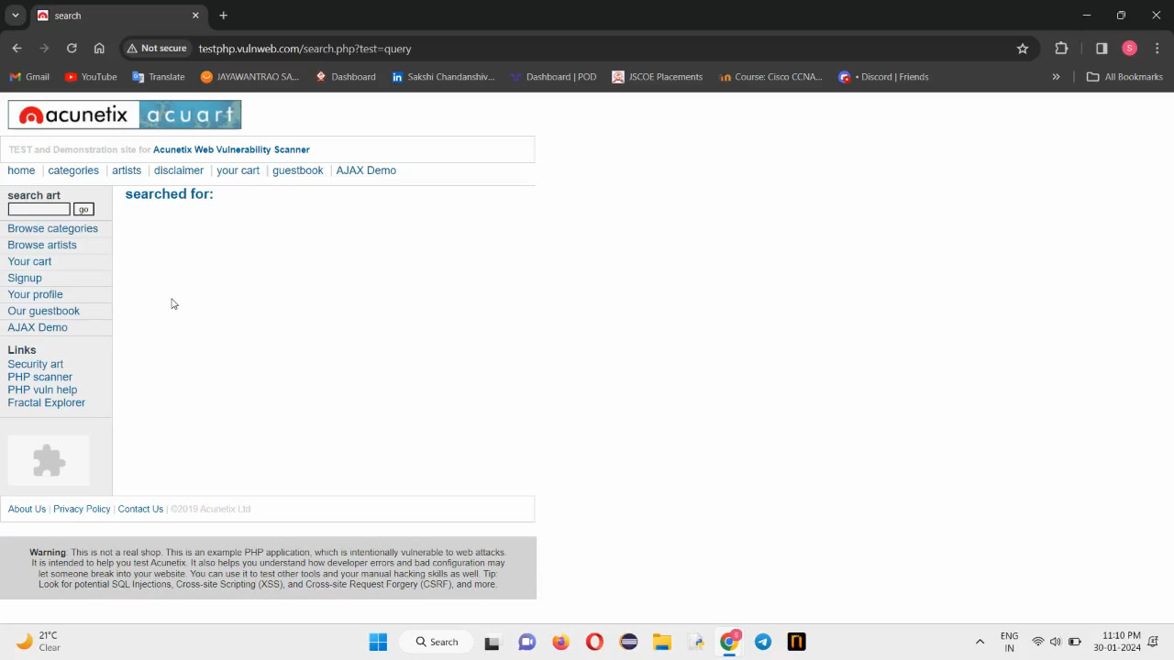
Below is the video of vulnerability using browser.

Slide 7
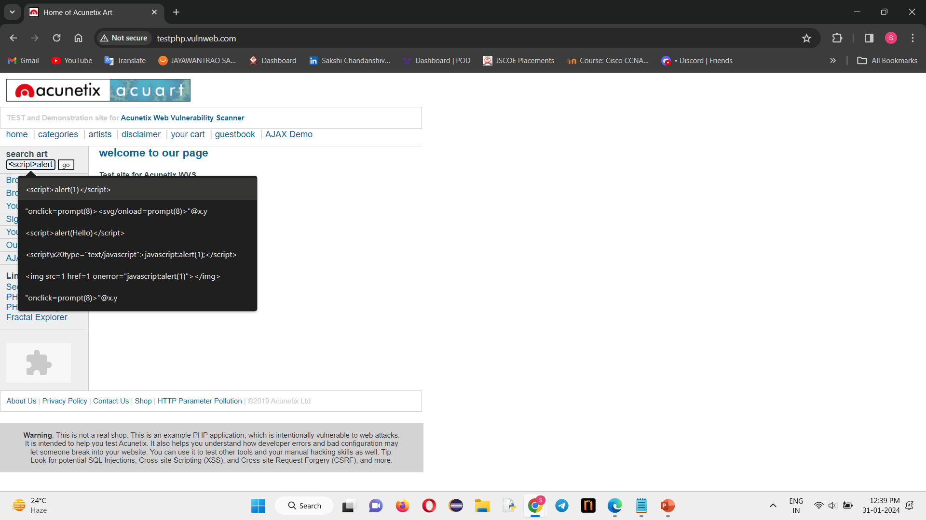
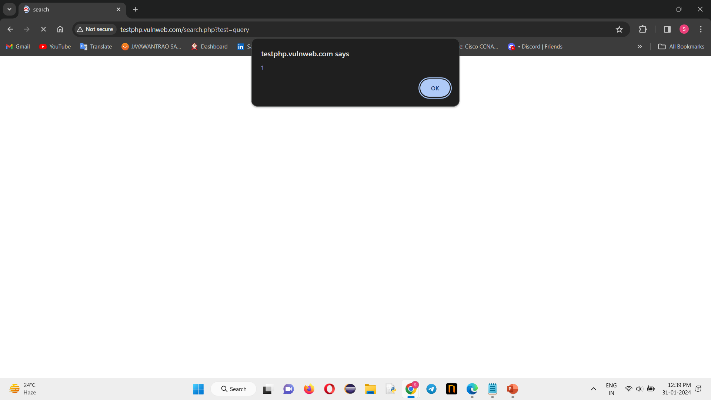
Below is the screenshot of vulnerability using browser.

Slide 8
Thank you

